Slide 1
UNIT – 4
Derived Distributions from Normal Distribution

Slide 2
Sample
To find things about a population of interest it is common practice to take a sample.
A sample is a selection of objects or observations taken from the population of interest.
For example a population might be all apples in an orchard at a given time.

Slide 3
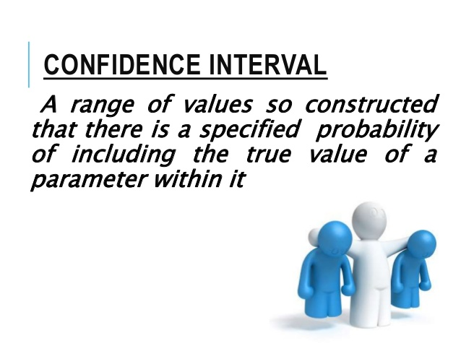

Slide 4
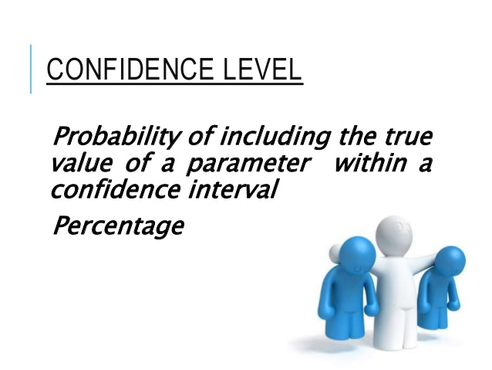

Slide 5
Confidence Interval
Example: Suppose you want to know what percentage of people in the India love Cricket.
The only one thing you can do in order to get a 100% correct answer to that question is by asking each one of the citizens in the India whether or not they love cricket.
Instead what we do is by getting a random sample of people and get the percentage of people who love cricket in that sample, but then we won’t be 100% confident that this number is right or how far is this number from the real answer, so, what we’ll try to achieve is get an interval

Slide 6
for example, a possible answer to that question may be: “I am 95% confident that the percentage of people that love soccer in the U.S. is between 58% and 62%”.
That’s where the name Confidence Interval come from, we have an interval, and we have some confidence about it.
If the sample percentage will fall 95% of the time between real percentage-3 and real percentage +3, then the real percentage will be 95% of the times between sample percentage -3 and sample percentage +3.
If we took a sample and got 63%, we can say that we 95% confident that the real percentage is between 60% (63 -3) and 66% (63+3).
This is the Confidence Interval, the interval is 63+-3 and the confidence is 95%.

Slide 7
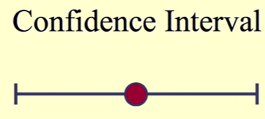

Confidence Interval

Slide 8
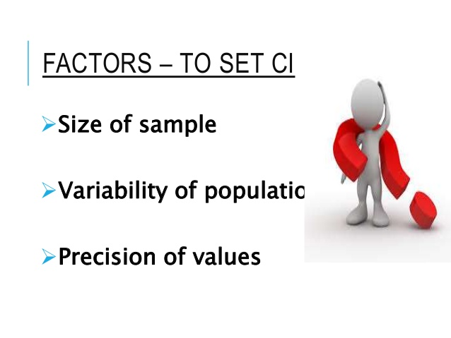


Slide 9
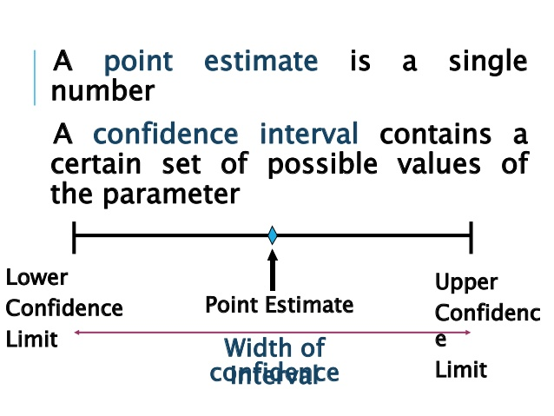

Slide 10
Derived distributions
Some frequently encountered continuous distributions are closely related to the normal distribution:
t-Distribution
Chi-Square distribution
F-distribution

Slide 11
Derived distributions
t-Distribution: Typically used for small sample numbers, when the true mean/SD are not known.
Chi-Square distribution: For describing variability of normally distributed data.
F-distribution: To compare variabilities of two sets of normally distributed data.

Slide 12
t-Distribution
William Gosset an English statistician
Developed different methods for the selection of the best yielding varieties of barley
Gosset was trying to develop meaningful predictions from small samples.
Gosset introduced the t-statistic also named as Student’s t.
This distribution allowed inference through small samples with an unknown population variance.
This distribution has plenty of real time applications.

Slide 13
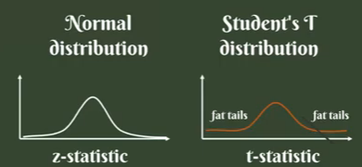
t-Distribution
Visually T-distribution looks similar to normal distribution
But has generally has fatter tails.
Fatter tails allows for a higher dispersion of variables as there is more uncertainty.

Slide 14

t-Distribution
z-statistic is related to standard normal distribution
t-statistic is related to T-distribution:

Slide 15
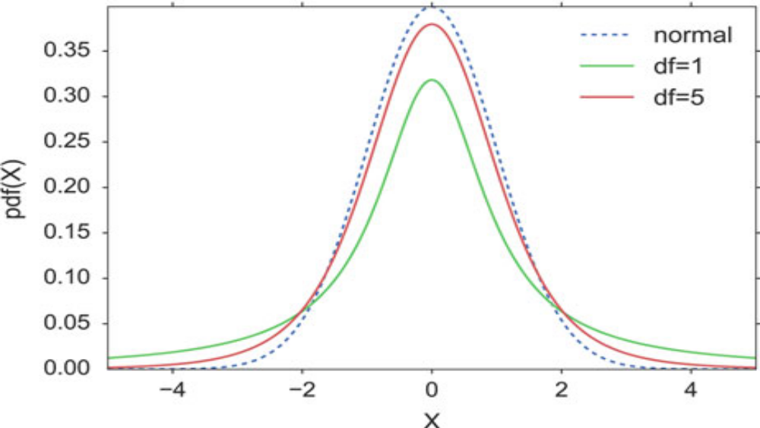
T-distribution
t-Distribution with DoF=1, DoF =5 and normal

Slide 16

T-distribution
Very frequent application of the t-distribution is in the calculation of confidence intervals for the mean.

Slide 17
T-distribution - Application
Calculate the t-values for the 95%-CI, for n = 20.
The lower end of the 95% CI is the value that is larger than 2.5% of the distribution;
the upper end of the 95%-CI is the value that is larger than 97.5% of the distribution.
These values can be obtained either with the percentile point function (PPF), or with the inverse survival function (ISF).

Slide 18
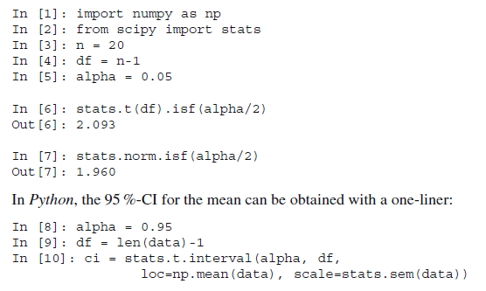
T-distribution

Slide 19
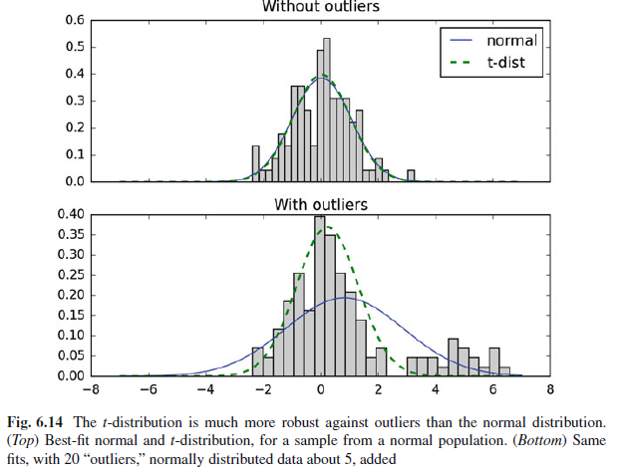
T-distribution
t-distribution has longer tails than the normal distribution
it is much less affected by extreme cases.

Slide 20
Chi-Square Distribution
The chi-square distribution is related to the normal distribution in a simple way:
if a random variable X has a normal distribution (X ϵ N(0; 1)),
then X² has a chisquare distribution, with one degree of freedom(X² ϵ ).

Slide 21

Chi-Square Distribution
The sum of squares of n independent and standard normal random variables have a chi-square distribution with n degrees of freedom:

Slide 22
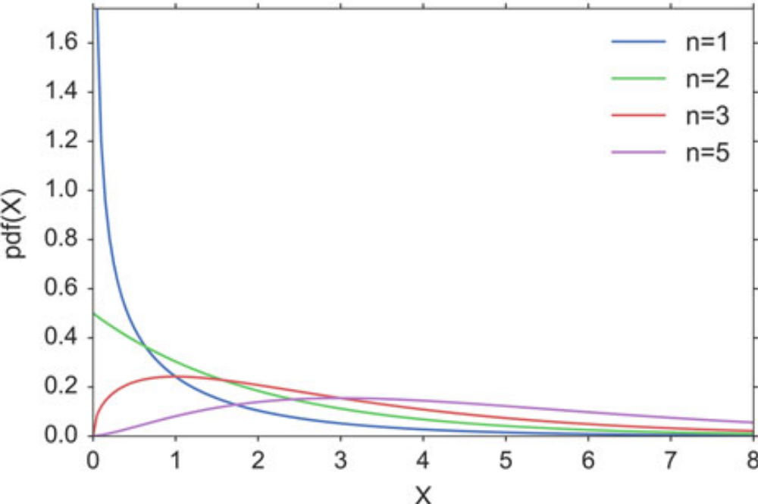
Chi-Square Distribution

Slide 23
Chi-Square Distribution - Application
A pill producer is ordered to deliver pills with a standard deviation of σ =0.05. From the next batch of pills n = 13 random samples have a weight of 3.04, 2.94, 3.01, 3.00, 2.94, 2.91, 3.02, 3.04, 3.09, 2.95, 2.99, 3.10, 3.02 g.
Question Is the standard deviation larger than allowed?

Slide 24

Chi-Square Distribution - Application
Since the chi-square distribution describes the distribution of the summed squares of random variates from a standard normal distribution
we have to normalize our data before we calculate the corresponding CDF-value:

Slide 25
Chi-Square Distribution - Application
Interpretation: If the batch of pills is from a distribution with a standard deviation of σ =0.05
The likelihood of obtaining a chi-square value as large or larger than the one observed is about 19%, so it is not atypical. In other words, the batch matches the expected standard deviation.

Slide 26
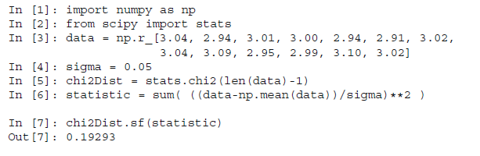
Chi-Square Distribution - Application

Slide 27

F-Distribution
This distribution is named after Sir Ronald Fisher,
Used in determining critical values in ANOVAs (“ANalysis Of VAriance”).
If we want to investigate whether two groups have the same variance, we have to calculate the ratio of the sample standard deviations squared:

Slide 28
F-Distribution
If we want to investigate whether two groups have the same variance, we have to calculate the ratio of the sample standard deviations squared:
S_{x} is the sample standard deviation of the first sample
S_{y} the sample standard deviation of the second sample

Slide 29
F-Distribution
For applications in ANOVAs, the cutoff values for an F distribution are generally found using three variables:
ANOVA numerator degrees of freedom
ANOVA denominator degrees of freedom
significance level

Slide 30


F-Distribution
An ANOVA compares the size of the variance between two different samples. This is done by dividing the larger variance by the smaller variance. The formula for the resulting F statistic is:

Slide 31
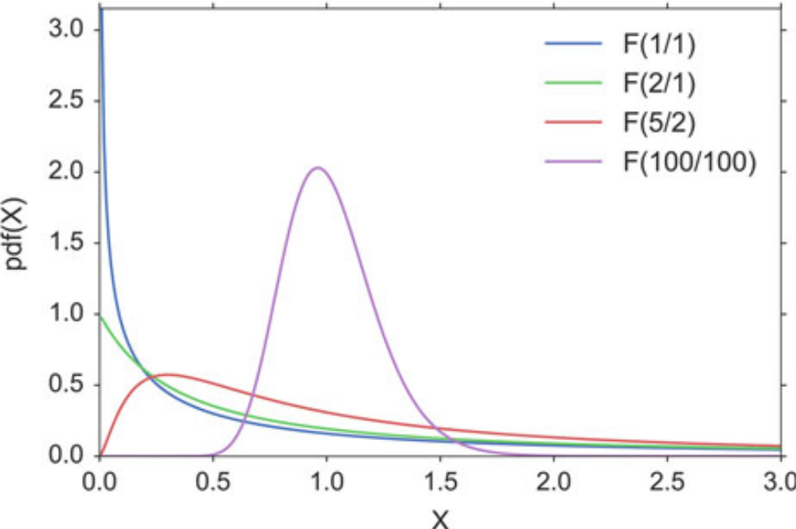
F-Distribution

Slide 32
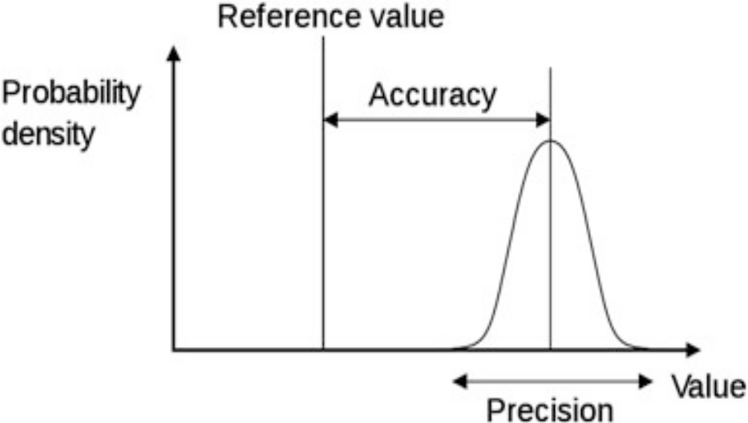
F-Distribution
Compare the precision of two methods to measure eye movements.
The two methods can have different accuracy and different precision.
As shown in the below Figure, the accuracy gives the deviation between the real and the measured value, while the precision is determined by the variance of the measurements. With the test we want to determine if the precision of the two methods is equivalent, or if one method is more precise than the other.

Slide 33
F-Distribution
Example: When you look 20º to the right, you get the following results:
Method 1: [20.7, 20.3, 20.3, 20.3, 20.7, 19.9, 19.9, 19.9, 20.3, 20.3, 19.7, 20.3]
Method 2: [ 19.7, 19.4, 20.1, 18.6, 18.8, 20.2, 18.7, 19. ]
The F statistic is F = 0:244, and has n-1 and m-1 degrees of freedom, where n and m are the number of recordings with each method.
The code sample below shows that the F statistic is in the tail of the distribution (p_oneTail=0.019), so we reject the hypothesis that the two methods have the same precision

Slide 34
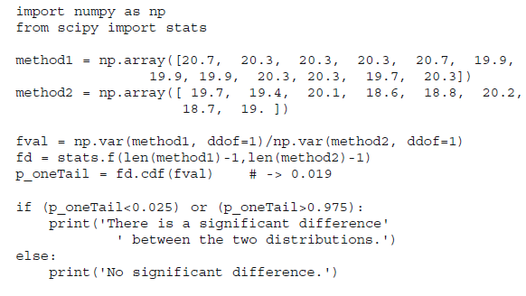
F-Distribution

